Slide 1
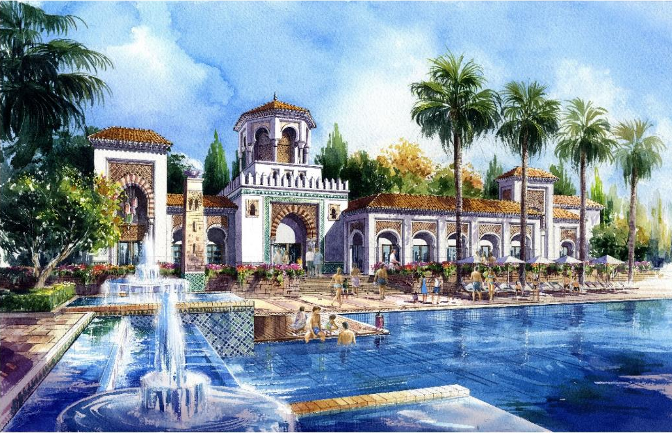
PROMOSHARM Company
PROMOSHARM
REAL ESTATE DEVELOPMENT
AND
TOURISM INVESTMENTS

Slide 2
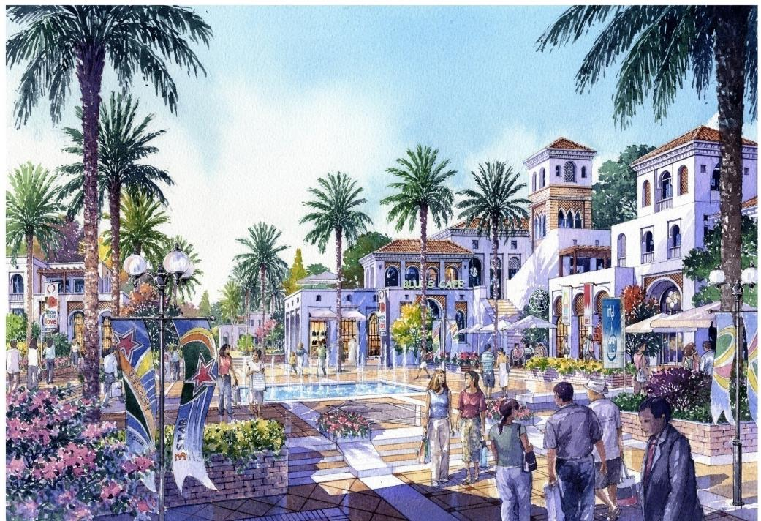
Vision
Creating Developments that provide world class resorts in the Middle East.
Mission
Aims at combining best in class customer service and hospitality with a firm dedication to quality and strong attention to details.

Slide 3
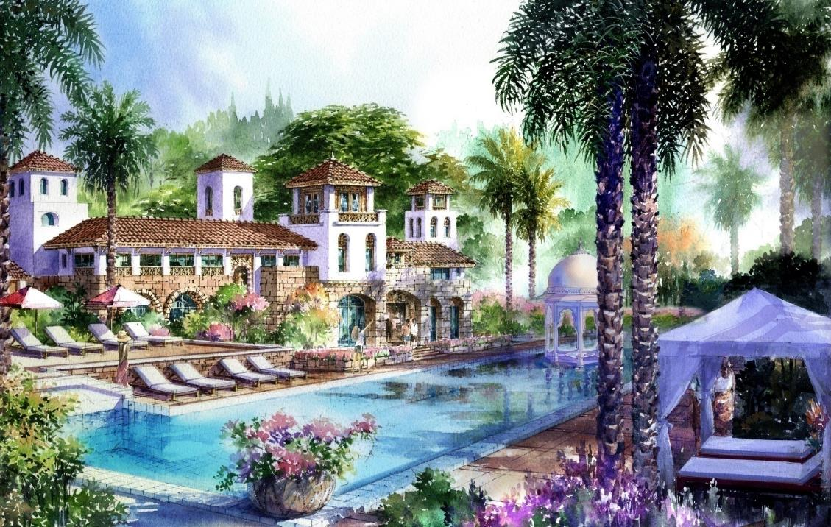
PROMOSHARM Company
Company name: Promosharm Company for Tourism Investment.
Project Name: Neama Town
The companies approved funds to set up a company Promosharm for Tourism Investment and real estate development as Egyptian Law Act No. 159 bayonets 1981.
The Governing Council:
Formed Governing Council as follows:
Mr. / Ashraf Haridy - Chairman
Mr. / Medhat Hammam – VP.

Slide 4
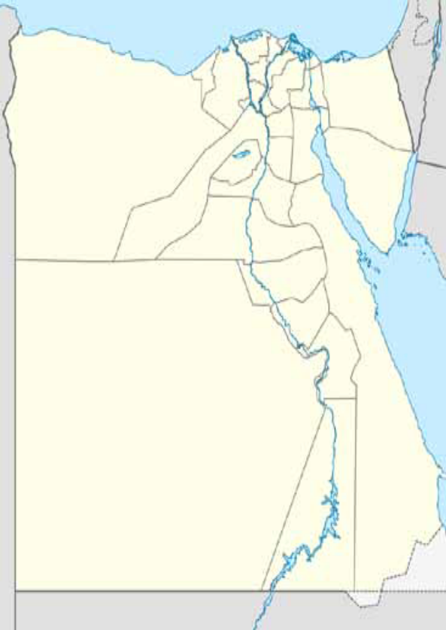
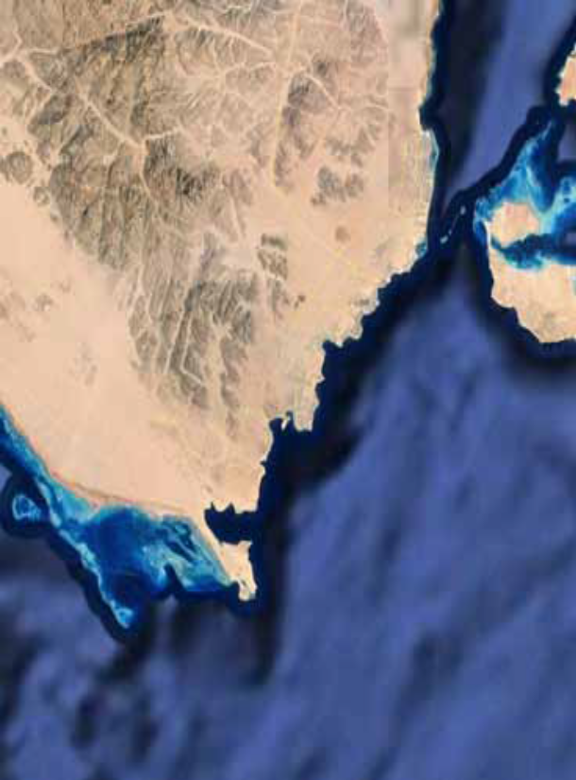
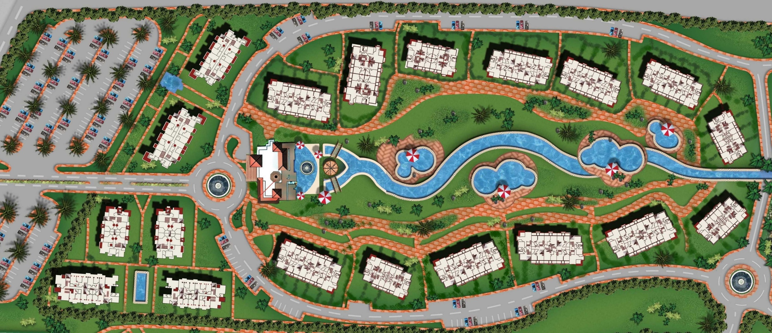
NEAMA TOWN Project
⇧
Sharm El Sheikh
PROMOSHARM
REAL ESTATE DEVELOPMENT
AND
TOURISM INVESTMENTS

Slide 5
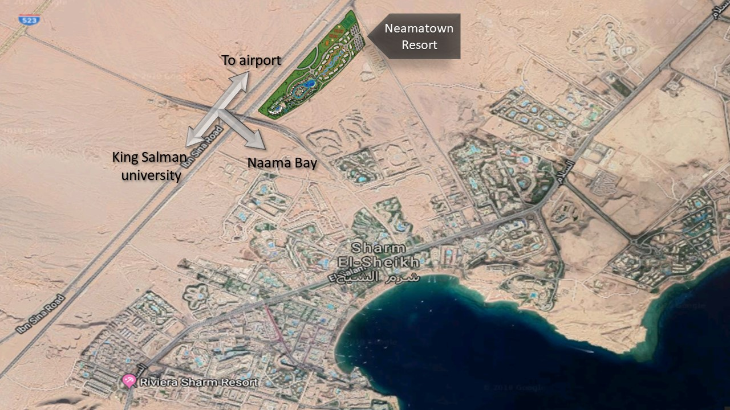
Location
The project is located in Neama Bay,
New area named Rabwat Neama,
Sharm El Sheikh city,
South Sinai Governorate.

Slide 6
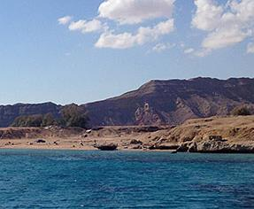
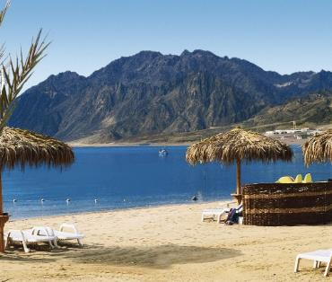
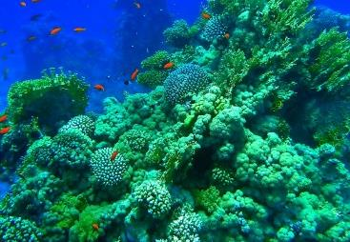
Why Sharm El Sheikh City?
One of the most attractive cities in Egypt,
Sharm lies at the southern tip of the Sinai Peninsula, One of 8 cities less pollution in the world,
The magnificent mountains with safari trips and parties,
Spectacular five star hotel resorts, amazing marine life, water sports, thrilling night life, a variety of shopping venues and world’s finest dive sites.
Ras Mohamed, a 15 minute drive from Sharm El Sheikh, was declared Egypt’s first National Park in 1983. It has hundreds of species of marine life, flora and fauna that exist nowhere else in the world.

Slide 7
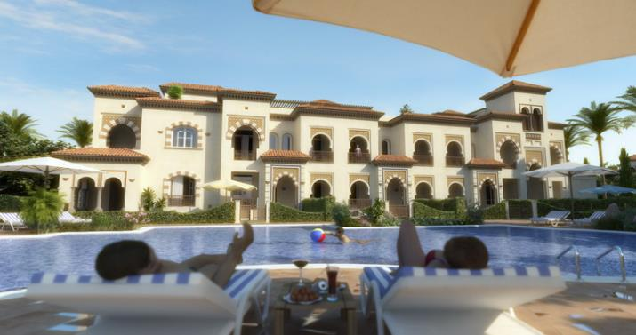
PROJECT DESCRIPTION
Neama Town’s location is elevated 100 meters above sea level, with a spectacular background of southern Sinai’s mountains.
The project is only a 15 minute walk away from the famous Neama Promenade, and a 7 minute drive from Sharm El Sheikh International Airport.
Neama Town offers the latest integrated real estate development project, incorporating top quality design landscape, highest level of service, professional state of the art techniques offering residential, commercial areas as well as a fully integrated residential area including studios, one and two bedrooms apartments and duplexes.

Slide 8
MASTER PLAN
La Residencia
Neama Town
The area of land 85 thousand square meters
Built Up area = 20% = 14,000 square meter, Phase one represents approximately 50% of the land area is already constructed.
Phase two is under preparation.
80% of the total area consists of Lakes, greenery, leisure, Sports and entertainment facilities.
Delivery Date: Starting of DEC 2019.
Various Stages of Buildings
Touristic, residential, hotel, leisure, entertainment and night life.
Offers a unique hotel apartment, development with landscaped pools, boardwalk, grand pool areas, health club, playgrounds, beach access and visitors amenities.

Slide 9

Project Designer
Designer: Creative Kingdom,
Experience: creators of Madinet Jumeirah, The Palm, and Century City, (Sun City) combines the excitement of Neama Bay with the serenity of your own home.
Their specialty: setting the mood, creating unique destinations and experiences. Previous landmark projects include The Palm and The World Islands in Dubai, Table Bay Hotel on the famous V & A Waterfront in Capetown, South Africa, master-planning Marassi and Gamsha Bay, the first entries into the Egyptian real estate market by UAE’s major developers, EMAAR and DAMAC, respectively.
Project Design: Set against the mountains backdrop, in lush greenery and waterscapes, the project offers numerous choices of hotel rooms, shopping venues and five star accommodations.

Slide 10
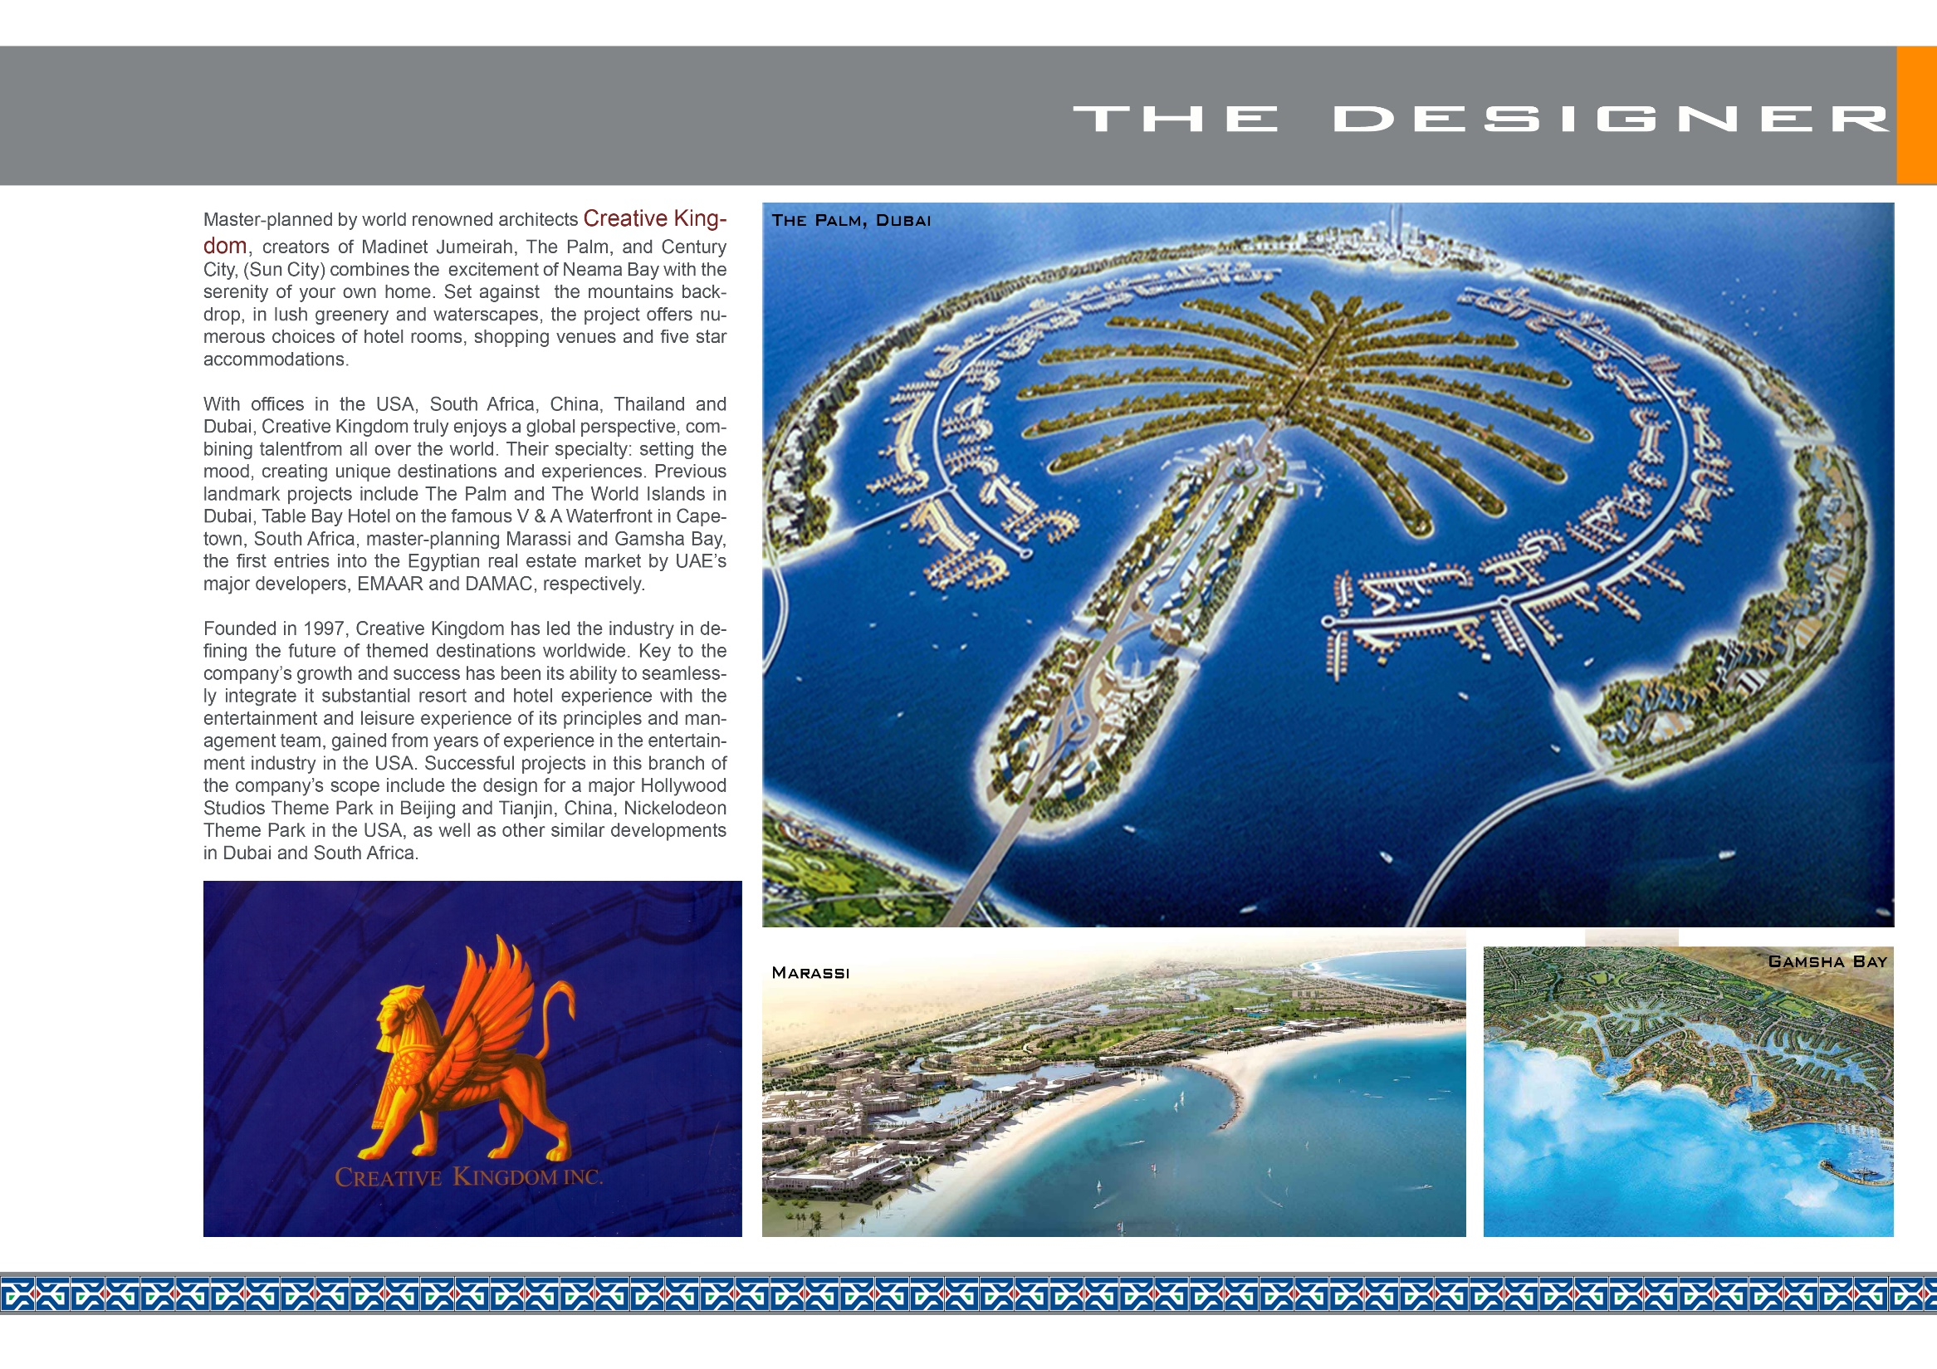

Slide 11


Slide 12



Design Awards

Slide 13
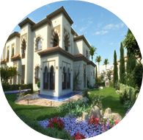
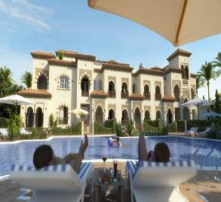
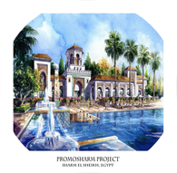
La Residencia - Phase one
5 Buildings
83 Apartments
1 bedroom and 2 bedroom apartment
Studio , duplex
7 Swimming pools
River
Aqua park
Club House
Hotel reception,
kitchen and Laundry
Coffee shop
Gym
Restaurants
business center
meeting rooms
Beach access

Slide 14
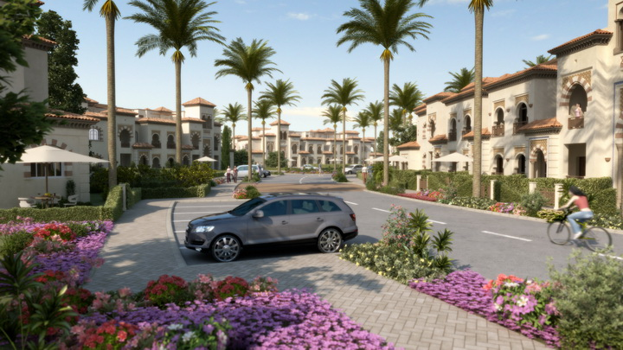
La Residencia

Slide 15
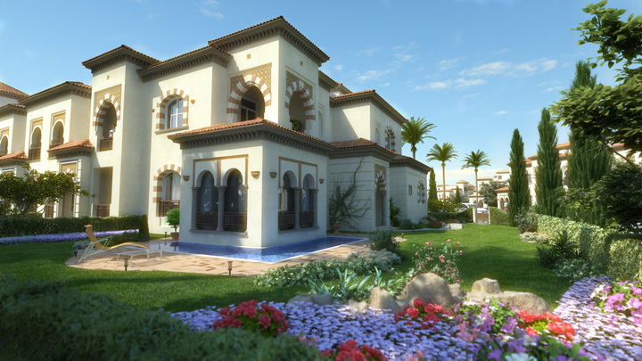
La Residencia
F l o o r p l a n s

Slide 16
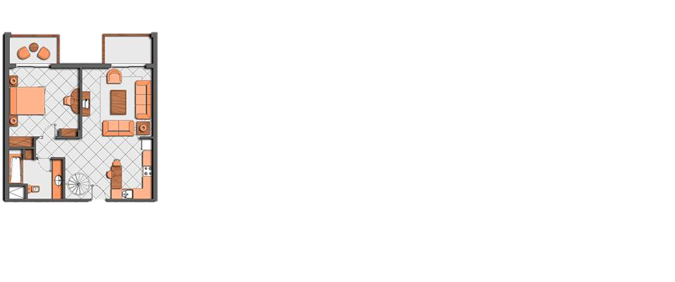
One bedroom
Ground floor Level:
Gf Area includes bedroom, bathroom, kitchen, Terrace & garden
1 bedroom unites area ranges between 75 MS, 80 MS, 85MS, 90MS
First floor Level:
Ff Area includes bedroom, bathroom, kitchen, Terrace & Roof

Slide 17
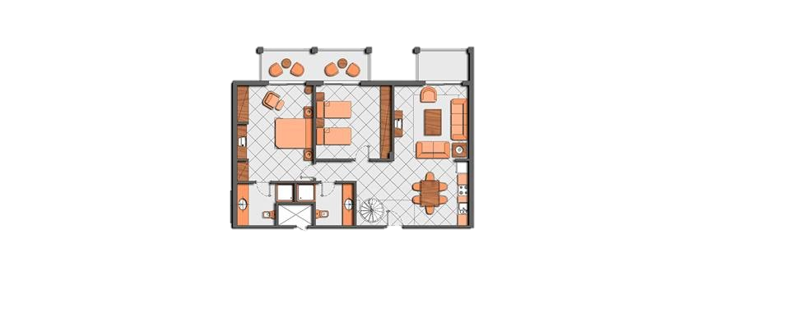
Two bedroom
Ground floor Level:
Gf Area includes 2 bedroom, 2bathroom, kitchen, Terrace & garden
2 bedroom unites area ranges between 90 MS & 140 MS
First floor Level:
Ff Area includes 2 bedroom, 2 bathroom, kitchen, Terrace & Roof

Slide 18
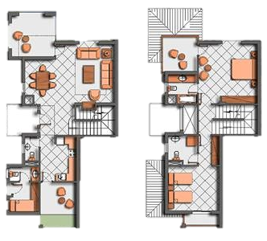
Duplex
Duplex includes 2 levels:
ground floor with garden & first floor with roof.
Duplex area ranged between 220 MS and 280 MS

Slide 19
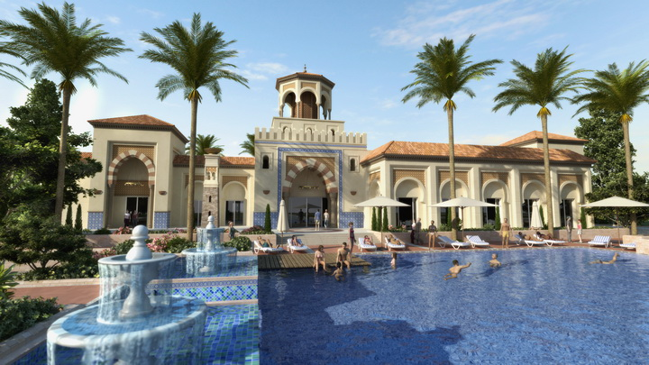
La Residencia

Slide 20
Neama town- Phase two
Apartment hotel, 376 hotel rooms.
Crystal clear water Lake
Gondolas
Grand Food Court
Super market / Shops
Restaurants
Bars
Coffee shops
Huge area for events
Entertainment area which makes it the center of night life in Sharm El Sheikh
SPA
GYM
A first class Spa that offers Jacuzzi, Steam room, Sauna, Cold-plunge pool and various massage techniques.

Slide 21
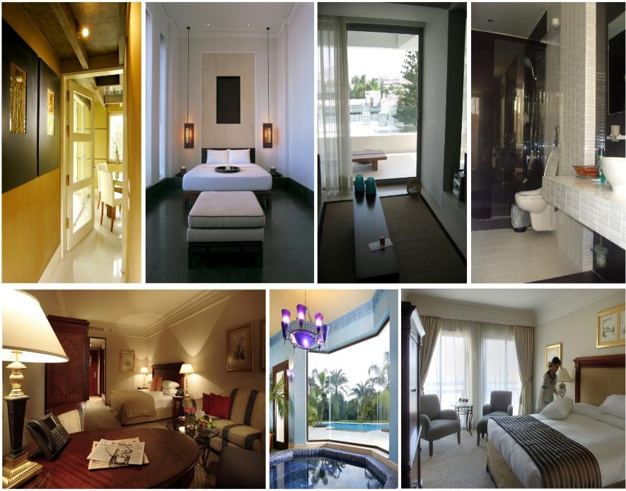
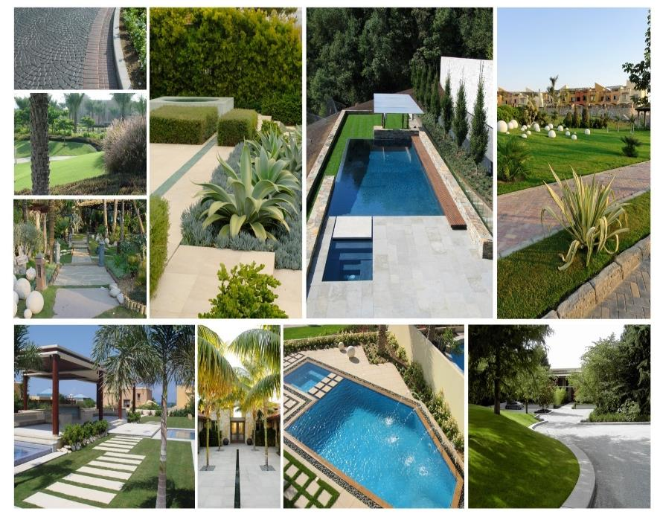
Rooms Interior
landscape

Slide 22
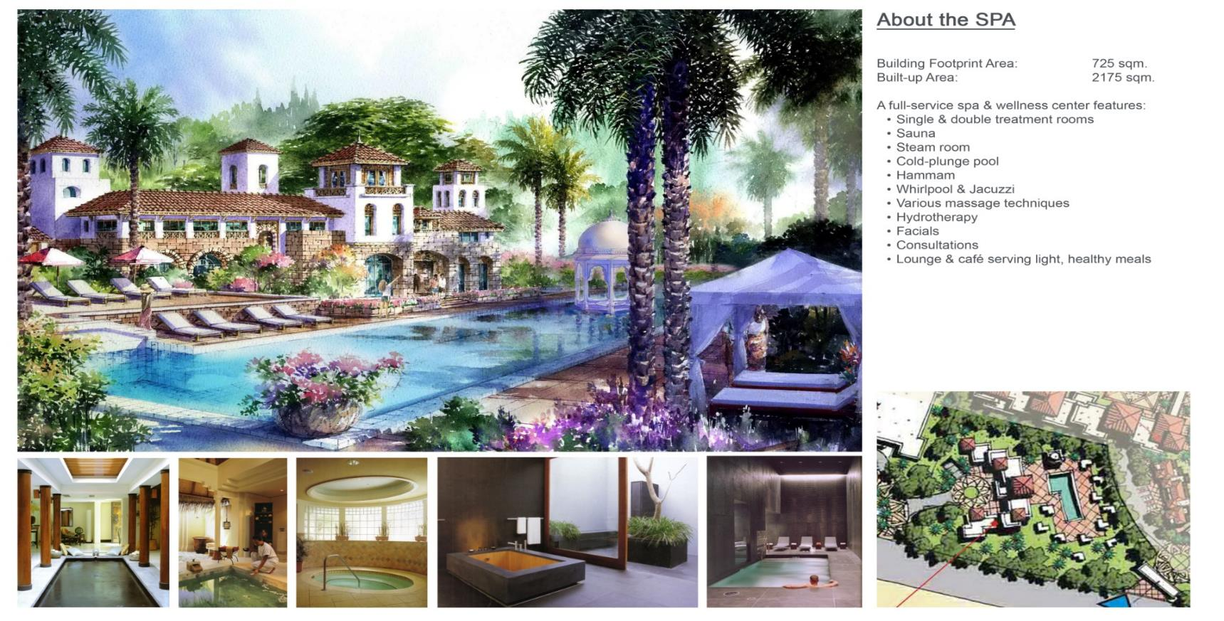
Spa

Slide 23
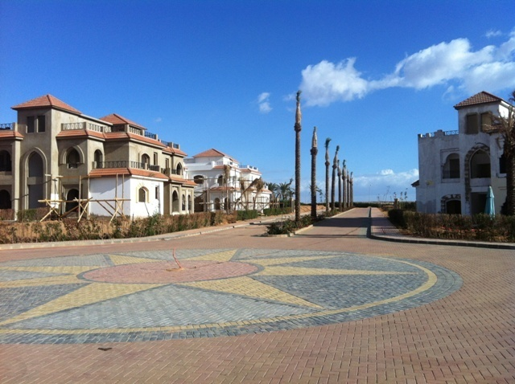
Construction Updates
PROMOSHARM
REAL ESTATE DEVELOPMENT
AND
TOURISM INVESTMENTS

Slide 24
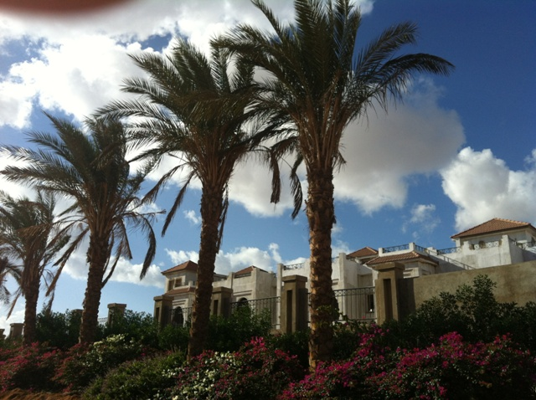
Site work

Slide 25
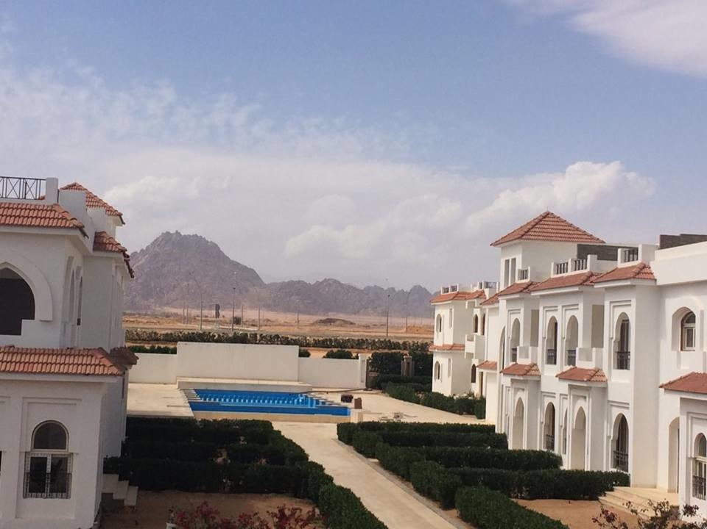
Site work

Slide 26
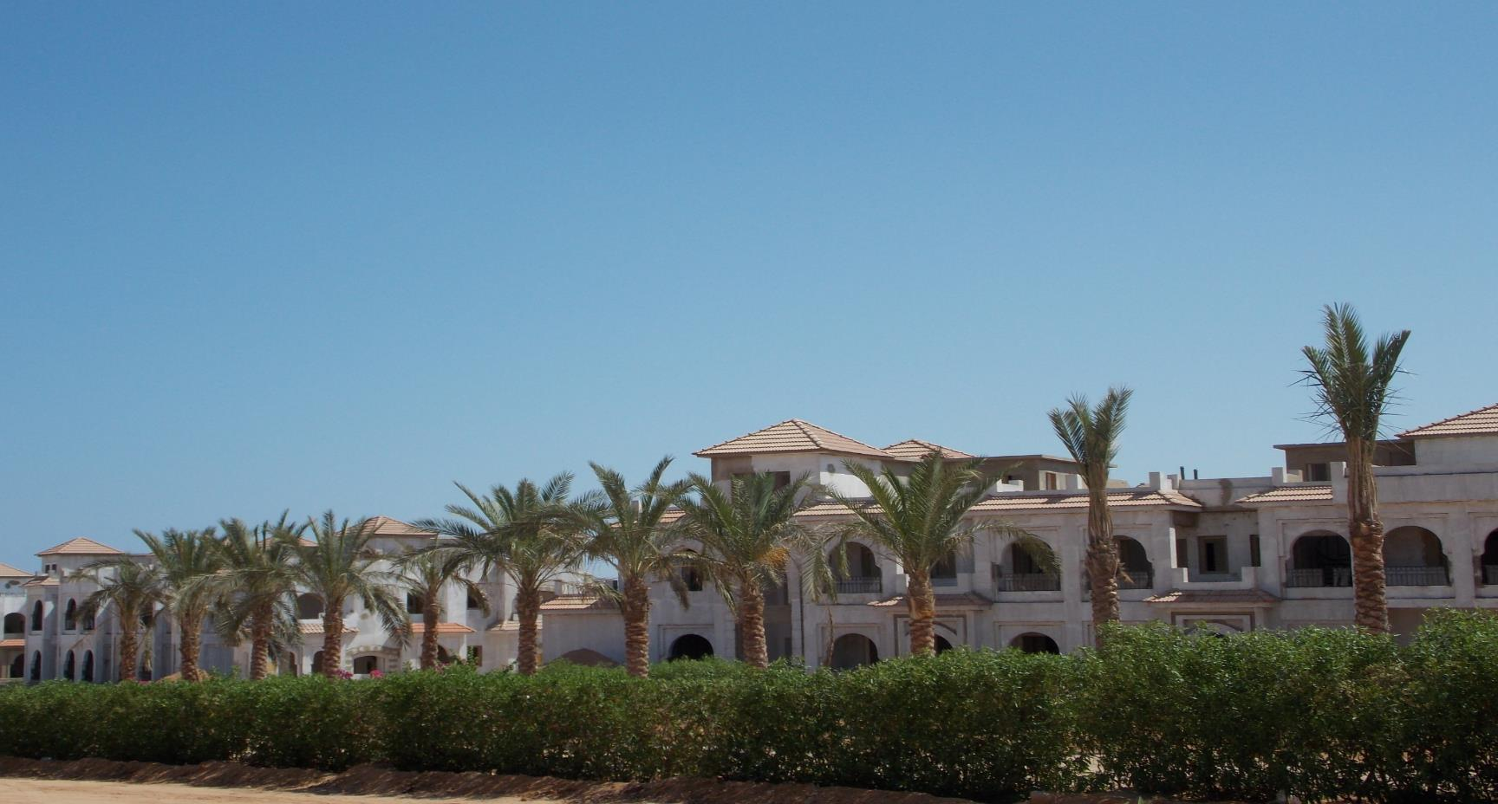
Site work

Slide 27
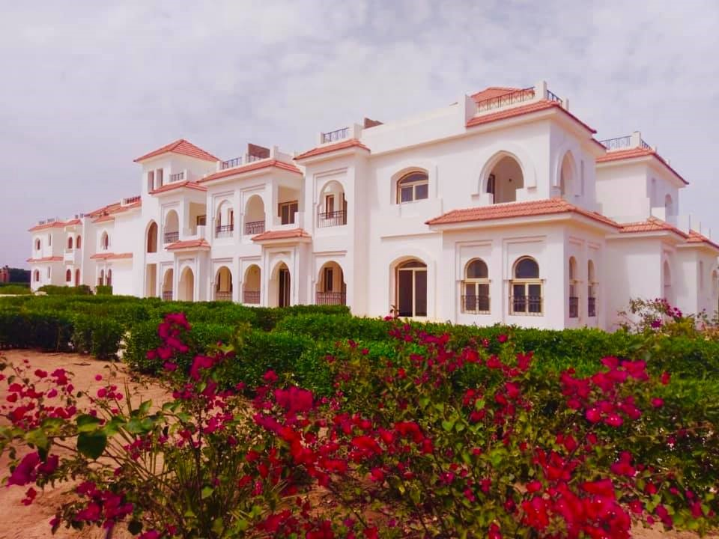
Site work

Slide 28
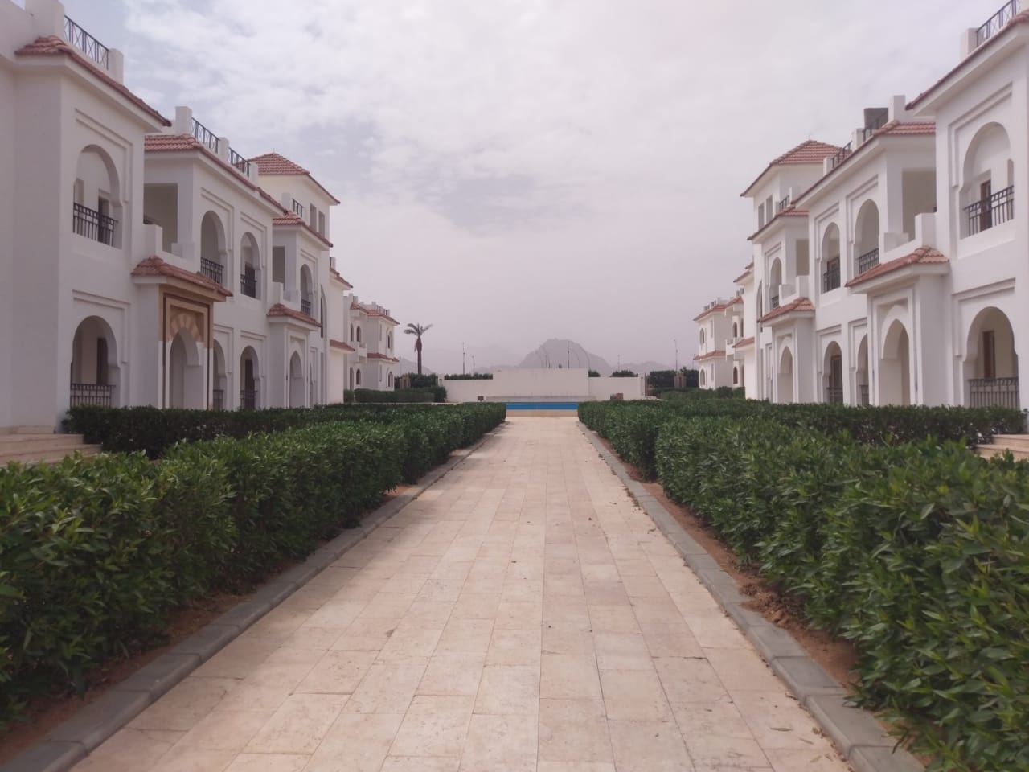
Site work

Slide 29
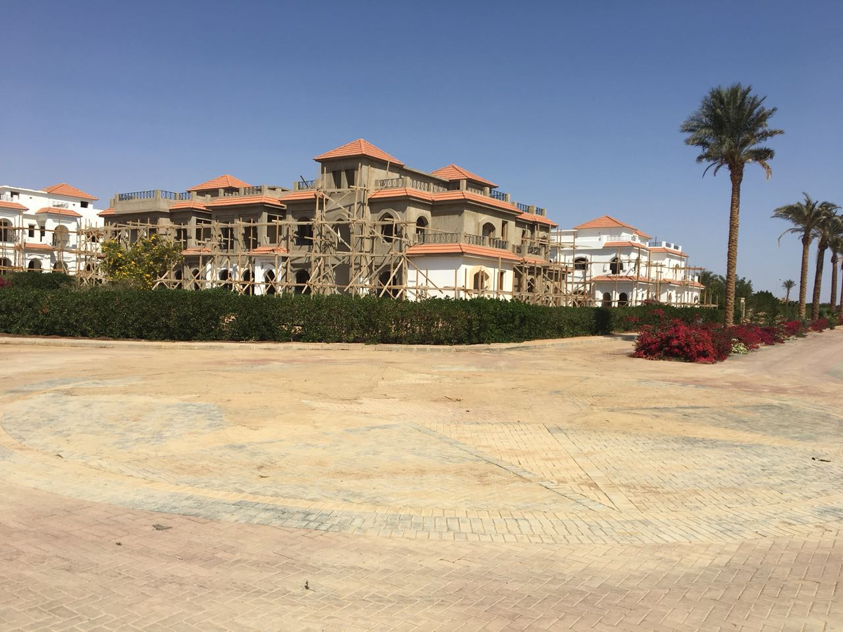
Site work

Slide 30
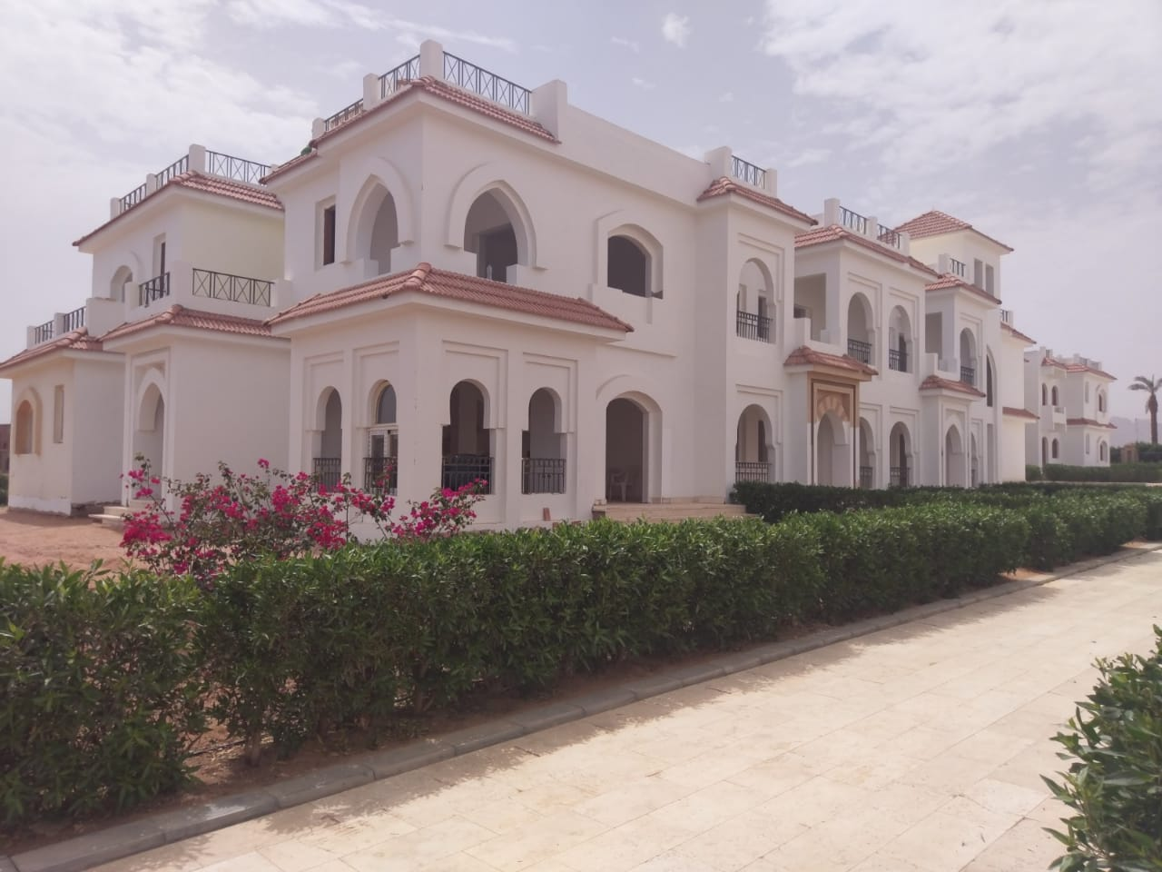
Site work

Slide 31
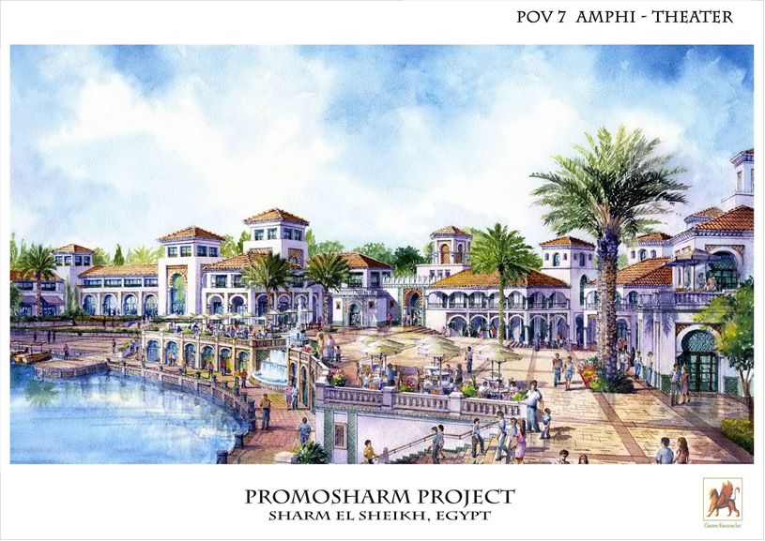
THANK YOU
PROMOSHARM
REAL ESTATE DEVELOPMENT
AND
TOURISM INVESTMENTS

